Slide 1
Types of AI Agents

Slide 2
Simple Reflex Agent
Model-based reflex agent
Goal-based agents
Utility-based agent
Learning agent

Slide 3
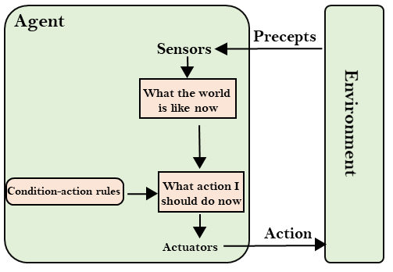
Simple Reflex Agent

Slide 4
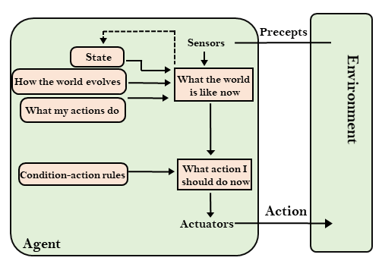
Model-based reflex agent

Slide 5
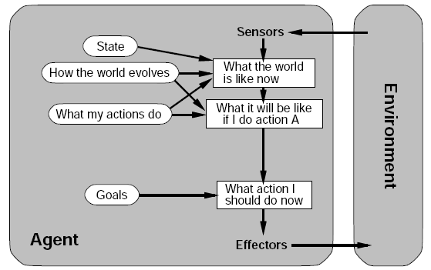
3. Goal-based agents

Slide 6
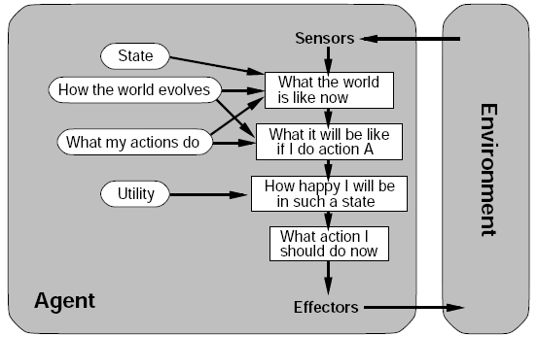
4.Utility Based agents

Slide 7
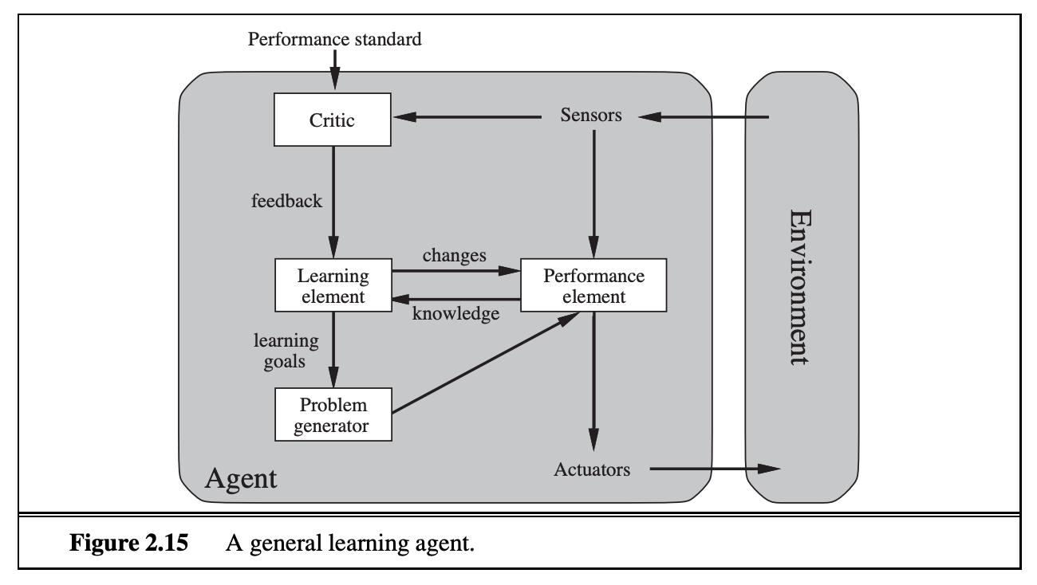
5.Learning Agents

Slide 8
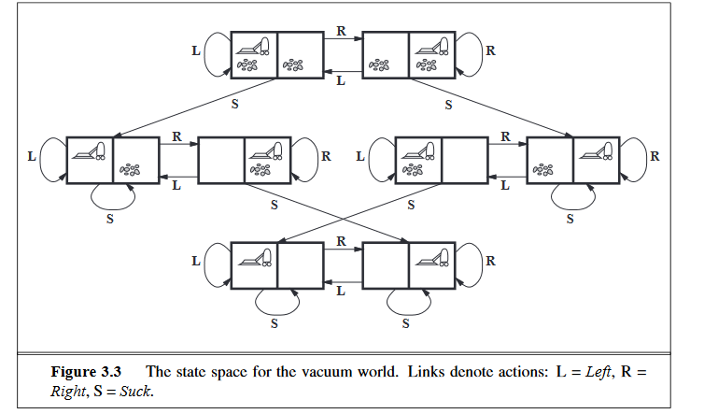
Toy Problems

Slide 9
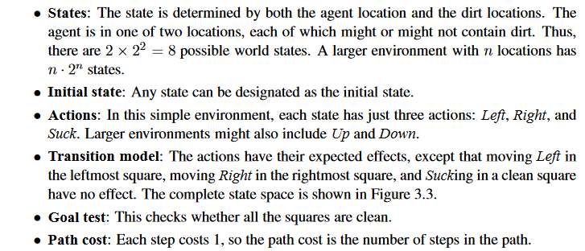

Slide 10
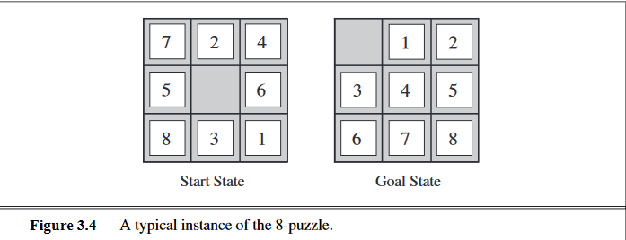

Slide 11
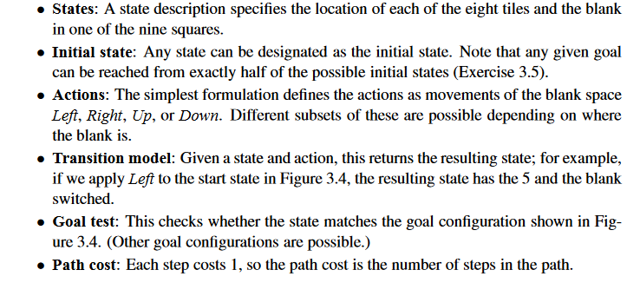

Slide 12
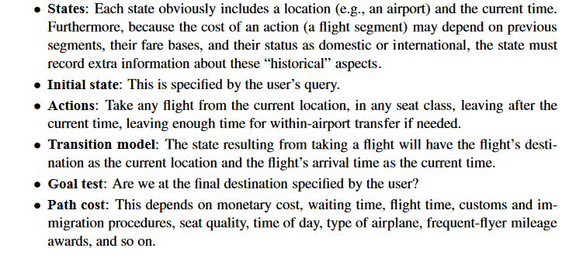
Real-World problems
Airline Travelling problem.

Slide 13
Searching for solutions
A solution is an action sequence.
Represented by Search tree .
root ----- initial state.
branches– actions.
nodes----- states.

Slide 14
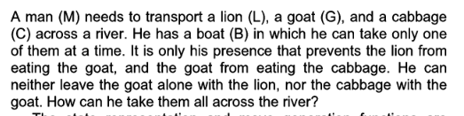
The Man,Lion,Goat,Cabbage Problem.

Slide 15
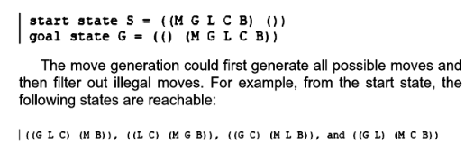


Slide 16
UNINFORMED SEARCH STRATEGIES
Search without information.
Blind search.

Slide 17
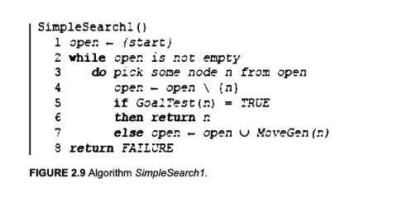
Simplesearch1( ) algorithm

Slide 18
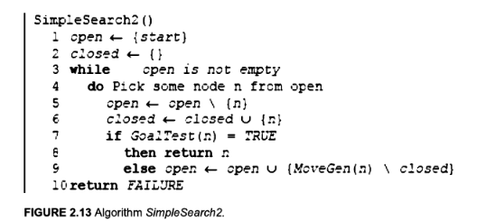
Simplesearch2( ) Algorithm

Slide 19
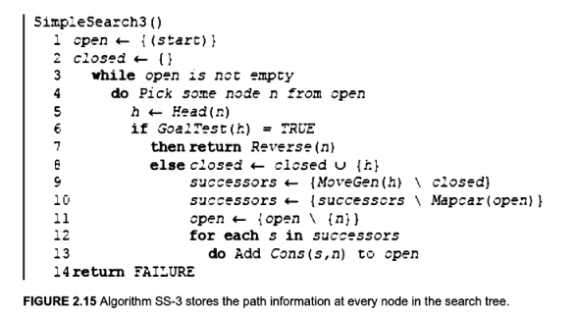
Simplesearch3( ) algorithm

Slide 20
Breadth First Search
First Come First Served basis.
Data Structure Queue is used for the purpose.
Uninformed search technique.

